Slide 1

Build A Dynamic Website on AWS with an SQL Database
Advanced Functionality, Security, and Cost Analysis
Vinodh
Raghavendiran
Nidhin
Himanshu Nimje

Slide 2

Dynamic Website on Aws
https://project3.raghavendiran.tech/
The service we used to build.
AWS RDS- MySQL
EC2
Frontend (react) &
Backend (python)

Slide 3
Introduction
What is a Dynamic Website?
A dynamic website is a website that changes as users interact with it. Dynamic websites can generate pages in real time, responding to characteristics such as screen size and device type.
Importance of a Dynamic Website
User experience
Social media integration
Interactive
Server-side programming
Easy to maintain
What is a SQL?
Structured Query Language (SQL) is a programming language that can communicate with databases. It is used to create, define, implement, access, maintain, and manipulate databases.
Importance of a SQL
Data manipulation
Create and manage databases
It helps handle structured data
SQL is highly accessible
Create a table
Retrieve data

Slide 4
project objectives and scope for the dynamic website on AWS using an SQL database
Project Objectives:
Create a Dynamic Website
Utilize SQL Database
Ensure Security
Optimize Performance
Analyse Cost
Scope:
Website Development
Database Management
Security Framework
Advanced SQL Features
Cost Analysis
Advantages of SQL:
Faster Query Processing
No Coding Skills
Scalability
Data Integrity
Backup and Recovery
The project aims to create a scalable, secure, and cost-effective solution for hosting a dynamic website with an SQL database on AWS.

Slide 5
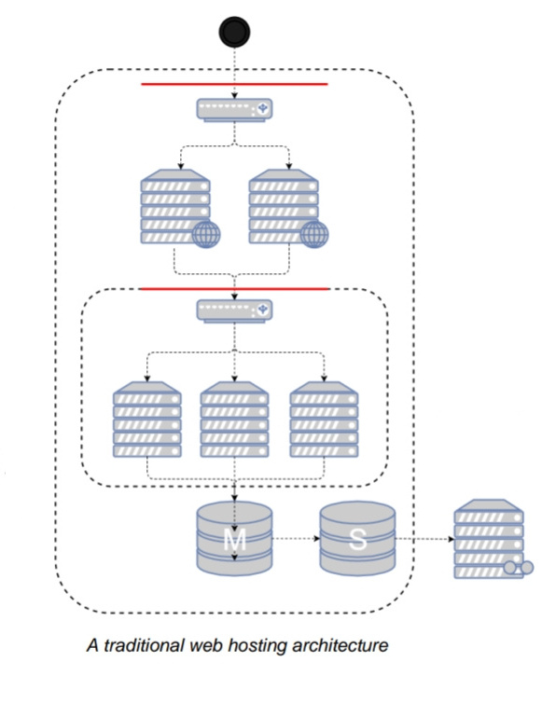
Traditional Web Hosting Architecture
Exterior Firewall- Hardware or software solution to open standard ports (80, 443)
Web Load Balancer- Hardware or software solution to distribute traffic over web servers
Web Server Tier- Fleet of web servers handling HTTP(S) requests
Interior Firewall- Limits access to application tied from web tier
App Load Balancer- Hardware or software solution to spread traffic over app servers
App Server Tier- Fleet of servers handling application- specific workloads
Data Tier- Database server machines with master and local running separately with network storage for static objects

Slide 6
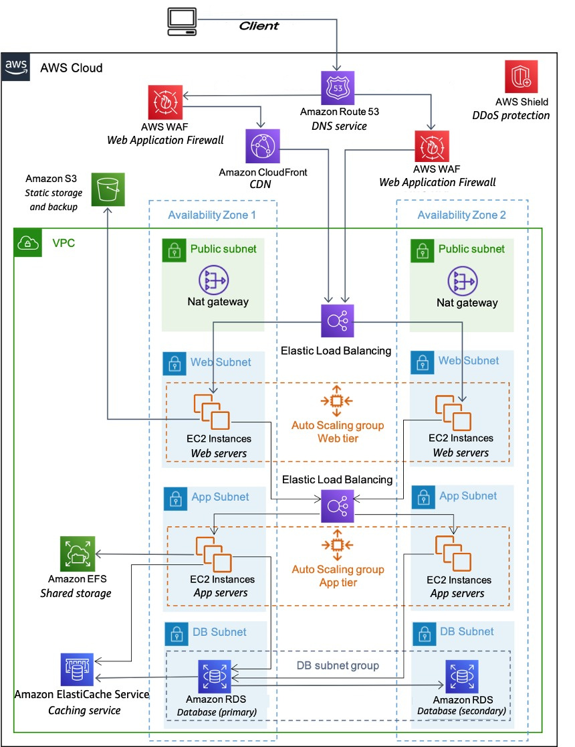
High level architecture Diagram for web hosting
Using Various Services to Build a Scalable Structure
DNS services with Amazon Route 53
Edge caching with Amazon CloudFront
Edge security for Amazon CloudFront with AWS WAF
Load balancing with Elastic Load Balancing (ELB)
DDoS protection with AWS Shield
Firewalls with security groups
Caching with Amazon Elastic cache
Managed database with Amazon Relational Database Service (Amazon RDS)
Static storage and backups with Amazon Simple Storage Service (Amazon S3)

Slide 7
Utilization of Advanced SQL Features
Complex Data Relationships:
Explanation: Complex data relationships involve defining and managing intricate connections between tables in the SQL database. This includes one-to-one, one-to-many, and many-to-many relationships.
Implementation: Utilize foreign keys and indexes to establish relationships between tables. Normalize the database structure to reduce redundancy and improve data integrity.
Importance: Complex data relationships ensure data consistency and accuracy by enforcing referential integrity constraints. They facilitate efficient data retrieval and manipulation operations, especially in large-scale applications with interconnected data entities.
Stored Procedures and Triggers:
Explanation: Stored procedures are precompiled SQL code blocks stored in the database server, which can be executed by invoking a procedure name. Triggers are special types of stored procedures that automatically execute in response to specific database events (e.g., insert, update, delete).
Implementation: Write stored procedures using SQL or procedural language extensions like PL/SQL (for Oracle) or T-SQL (for Microsoft SQL Server). Define triggers to enforce business rules, maintain audit trails, or automate data validation tasks.
Importance: Stored procedures and triggers enhance database functionality and data integrity by encapsulating business logic within the database layer. They improve performance by reducing network latency and minimizing round trips between the application and database servers.

Slide 8
Advanced Functionality
User Authentication and Authorization
Implementation: Utilize AWS Cognito for user authentication, which provides a secure and scalable user directory. Implement OAuth 2.0 or OpenID Connect for single sign-on (SSO) capabilities.
Importance: User authentication ensures that only authorized users can access the website's resources. Authorization mechanisms control access levels and permissions based on user roles, enhancing security and data integrity.
Real-time Data Updates
Implementation: Implement WebSocket or Server-Sent Events (SSE) to enable real-time communication between the client and server. Utilize frameworks like Socket. WebSocket abstraction and simplified event-based communication.
Importance: Real-time data updates enhance user experience by providing instant updates and notifications without the need for manual refreshes. This feature is crucial for applications requiring live data feeds, chat functionality, or collaborative editing.

Slide 9
SQL Database Management in AWS
Amazon RDS simplifies database management tasks and supports multiple SQL database engines.
Features include scalability, security, automated backups, and monitoring.
Multi-AZ deployments provide high availability by replicating data across different Availability Zones.
Read replicas offload read-heavy workloads and improve scalability.
Automated backups and snapshots ensure data protection and disaster recovery.
These features are crucial for maintaining uptime, scalability, and data integrity in AWS-hosted SQL databases.

Slide 10
Comparative Analysis of Database Technologies
Comparative Analysis of Database Technologies
Factors considered:- Scalability, performance, data modeling, and query capabilities.
SQL databases offer strong data consistency and ACID compliance but may face scalability challenges.
NoSQL databases provide flexible schema design, horizontal scalability, and high performance for unstructured data.
NewSQL databases combine SQL and NoSQL features, offering scalability and ACID compliance.
Graph databases excel in handling complex relationships and querying interconnected data.
Pros and cons of each approach should be carefully evaluated based on application requirements and use cases.

Slide 11
Security Framework for SQL Database
Implement fine-grained access control using IAM (Identity and Access Management) for precise permission management.
Ensure data encryption at rest and in transit using AWS Key Management Service (KMS) and SSL/TLS protocols.
Deploy intrusion detection systems and auditing with AWS services such as Amazon Guard Duty and AWS CloudTrail.
IAM enables granular control over database access, reducing the risk of unauthorized data exposure.
Encryption at rest and in transit secures data from unauthorized access both in storage and during transmission.
Intrusion detection systems and auditing provide real-time monitoring and logging of database activities, enhancing security posture and compliance adherence.

Slide 12
Disaster Recovery Strategies
AWS provides several options for implementing robust disaster recovery strategies
Cross-Region Replication- Replicating databases across different AWS regions using services like Amazon RDS Multi-AZ, Aurora Global Database, or manual replication setups provides redundancy and enables failover to a secondary region in case of a regional outage.
Automated Backups and Snapshots- AWS services like Amazon RDS and Amazon Aurora offer automated backup and snapshot functionalities. Regularly backing up databases and storing snapshots in different regions or accounts ensures data durability and facilitates quick recovery.
Backup and Restore Procedures- Implementing backup and restore procedures, including regular testing of backups and disaster recovery plans, is crucial for mitigating risks associated with data loss and ensuring business continuity.

Slide 13
Cost Analysis of SQL Databases
Breakdown of cost factors: Instance types, storage, data transfer, and scalability.
Recommendations for optimization:
Choose instance types based on workload and performance needs.
Utilize reserved instances for cost savings on predictable workloads.
Implement data lifecycle policies for storage cost management.
Monitor and adjust instance sizes based on performance metrics.
Use scaling policies for dynamic capacity adjustments.

Slide 14
Conclusion
A successful website deployment on AWS requires a balance of advanced functionality, robust security, cost optimization, and disaster recovery preparedness. Advanced features like user authentication and real-time updates enhance user experience, while strong security measures protect sensitive data. Cost optimization ensures efficiency without compromising performance. Additionally, having a robust disaster recovery plan in place, including regular backups, replication across multiple AWS regions, and automated failover mechanisms, is essential for minimizing downtime and data loss in the event of a catastrophic failure. Moving forward, ongoing monitoring, adaptation, and collaboration are key to sustained success in the evolving landscape of web development and cloud computing.

Slide 15
Thankyou.

